Slide 1


Traffic simulation and Prediction
Presented by:
Dhanunjaya Lakshman Koneru – 16336828
Sushmitha Pollapalli - 16336844
Srilakshmi Allam - 16337561

Slide 2

Introduction
Traffic Congestion: A Growing Challenge
Description: In major cities, traffic jams during peak hours lead to long delays.
Impact: Diminished economic productivity and reduced overall quality of life for residents.
Objective: Develop innovative solutions using time series forecasting to ease traffic congestion and improve urban mobility.

Slide 3
Time Series Forecasting for Traffic Congestion
Machine Learning Technique - Time Series Forecasting
Data Sources: Utilizing data from diverse sources, including Chicago Traffic Tracker - Congestion Estimates by Region
Model Building: Creating a predictive model to estimate traffic congestion patterns based on historical data.
Benefits: Improved traffic flow management, reduced travel times, and enhanced urban mobility.

Slide 4
Dataset 1: Chicago Traffic Tracker - Historical Congestion
Estimates Source: City of Chicago Data Portal
Time Period: January 2018 to Current
Data Availability: Historical estimated congestion for 29 traffic regions
Data Collection: Continuous monitoring and analysis of GPS traces from CTA buses

Slide 5
Dataset 2: Chicago Traffic Tracker - Congestion Estimates by Region
Source: City of Chicago Data Portal
Traffic Regions: 29 regions in Chicago
Data Update Frequency: Every 10 minutes “LAST_UPDATE”
Key Column: "CURRENT_SPEED" reflecting region condition level

Slide 6

Libraries Used
Matplotlib
Numpy
Pandas
Folium
Statsmodels
OSMnx
Networkx

Slide 7
Methodology
Data Acquisition
Data Cleaning and Transformation
Data Representation on Map
Data Preparation for modeling
Model development and Training
Data Visualization

Slide 8
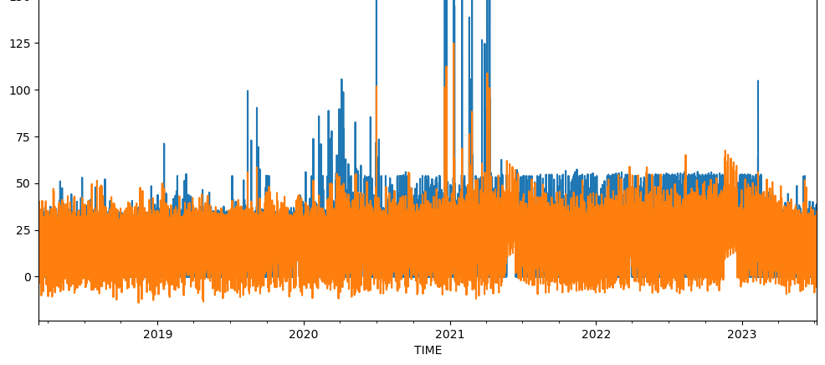
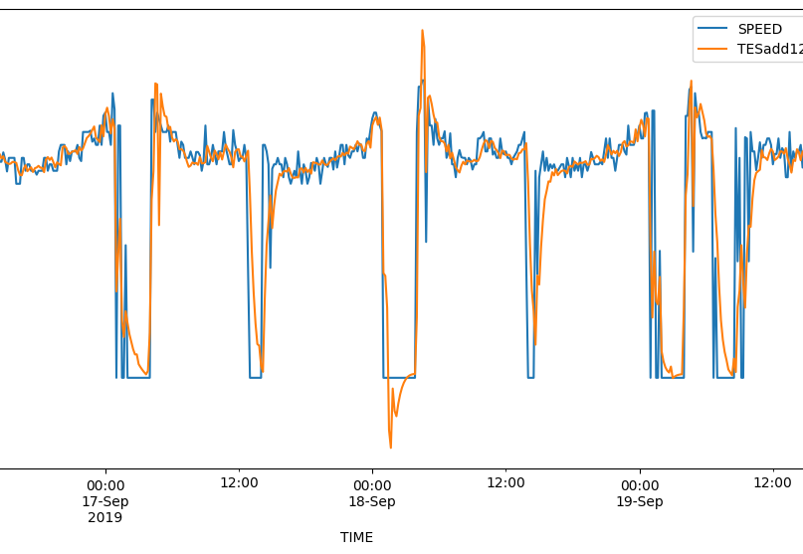
Results
In simple terms, Triple Exponential Smoothing is the best model for forecasting future traffic congestion.

Slide 9
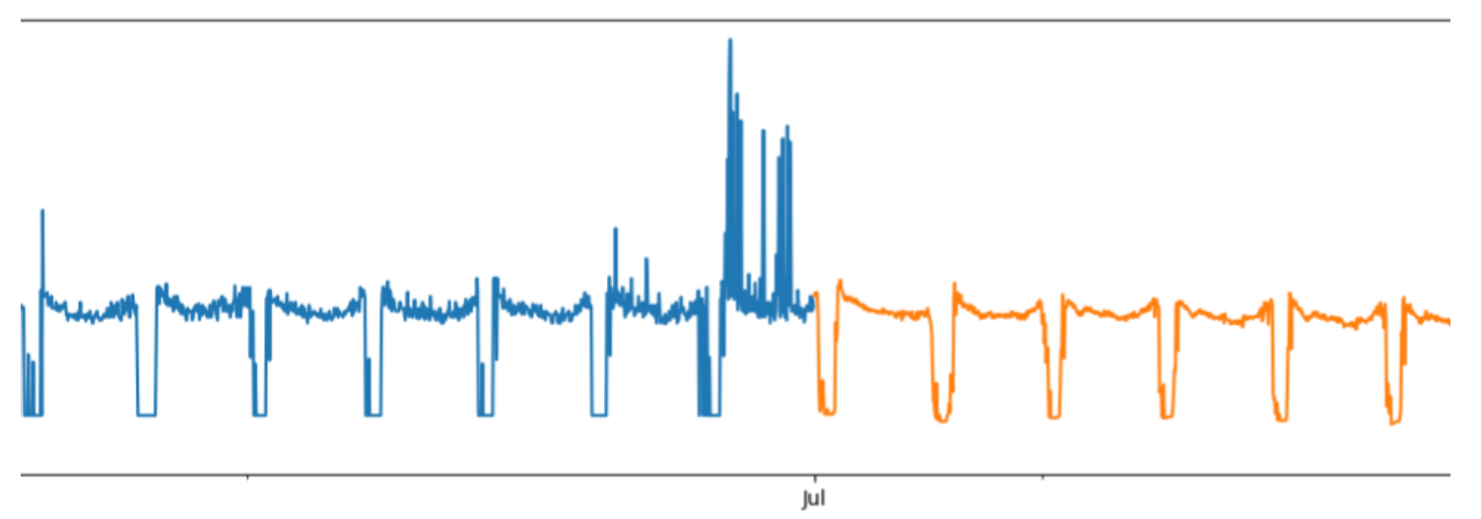

Slide 10
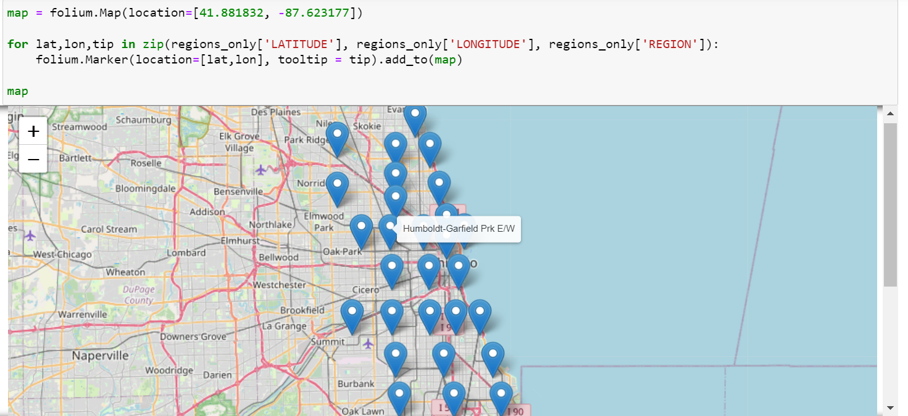

Slide 11
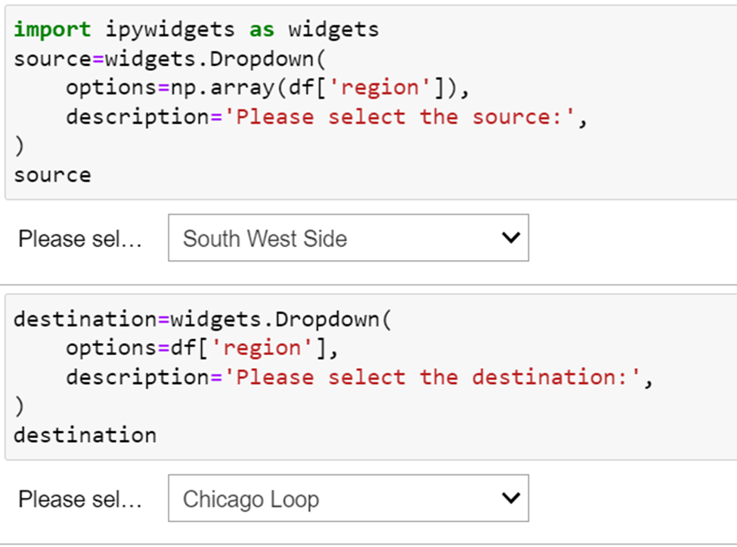
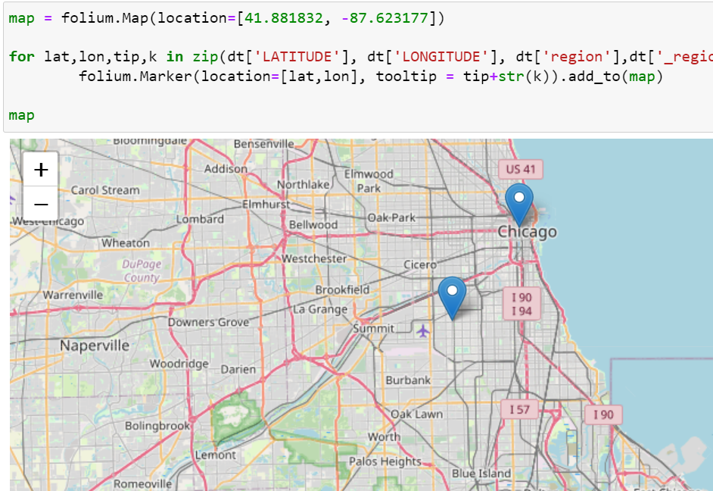

Slide 12
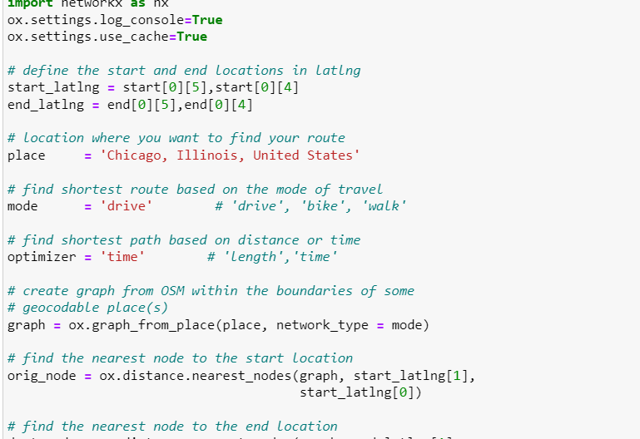
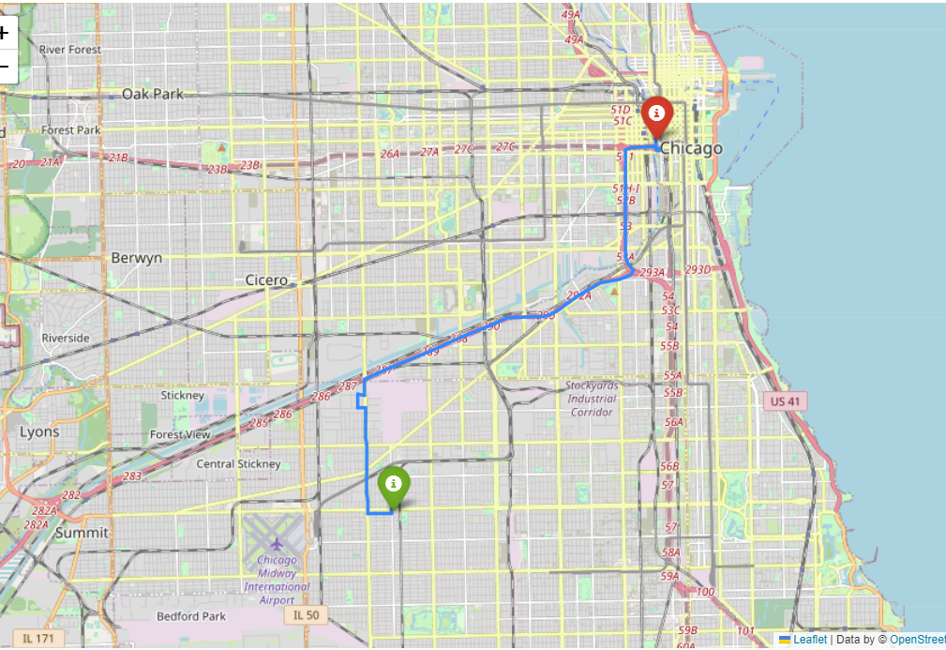
Shortest path from source to destination

Slide 13
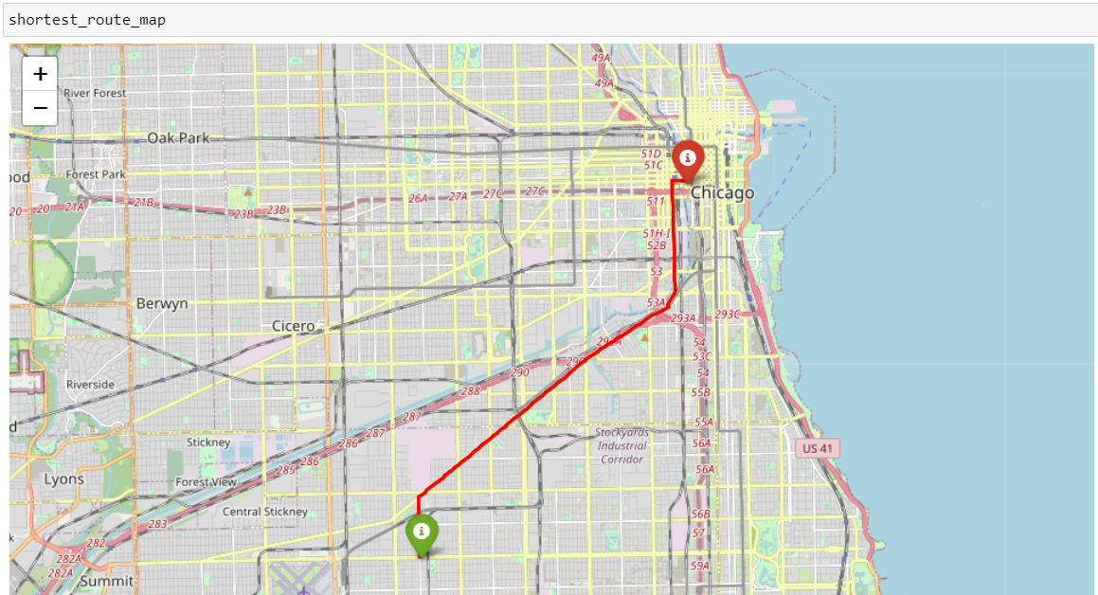
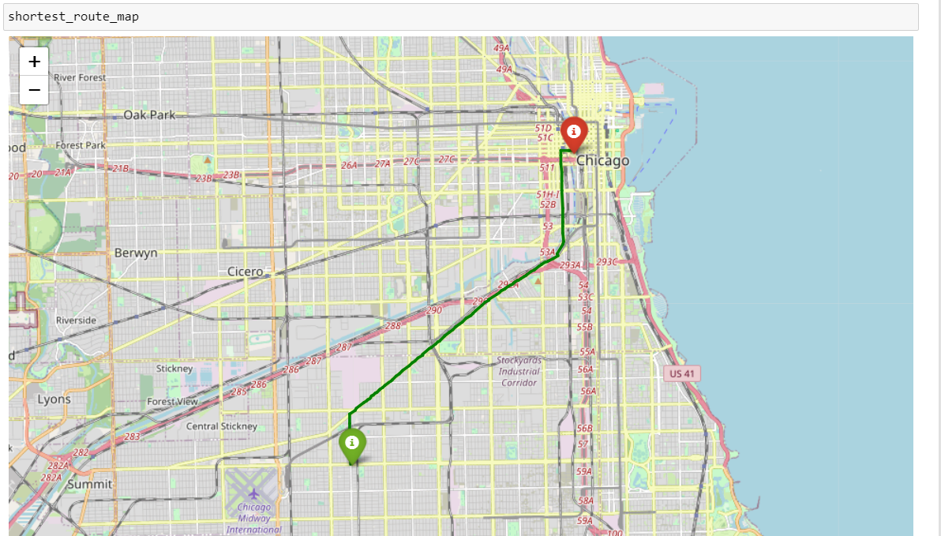
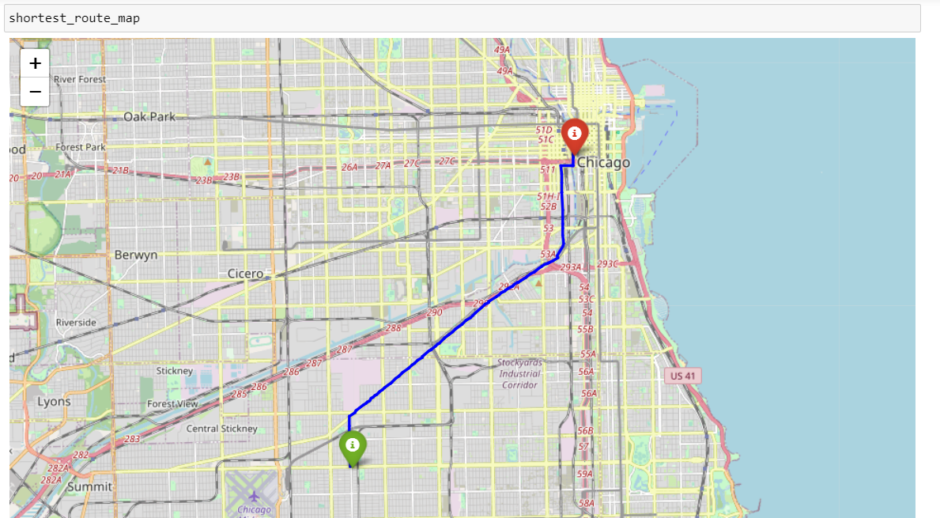
THREE ALTERNATIVE ROUTES

Slide 14
challenges
Large Data volume and Processing
Finding missing dates and inputting them with forward and backward fill.
Data is not at regular intervals of time.
For the three alternative routes, we have got some routes the same as the original one but it is a rare case.

Slide 15
Future work
Scalability and Generalization
Weather Impact
Seasonal Factors
Holiday and Event Impact
User Surveys

Slide 16

contributions
Srilakshmi Allam
Data collection and cleaning
Sushmitha Reddy Pollapalli
Time Series Forecasting and model selection
Dhanunjaya Lakshman Koneru
Finding the shortest path and the alternate routes

Slide 17

DEMO…….

Slide 18

THANK YOU

